Slide 1


BANKING CHURN DATA ANALYTICS -
PROJECT PRESENTATION
PRESENTED BY:
RISHABH KUMAR

Slide 2


TABLE OF CONTENTS
Summary of Project.
KPI List.
EXCEL Dashboard.
SQL Queries.
Conclusion.
Key Insights.

Slide 3

SUMMARY OF THE PROJECT
Banking Customer Churn Analysis is a data analytics effort aimed at determining the variables that influence customer attrition and enhancing retention. I used Excel and SQL to evaluate customer demographics, financial behavior, and product usage to identify churn tendencies.
The project includes interactive dashboards, important KPIs, and actionable business insights that enable data-driven strategies for reducing churn, increasing customer engagement, improving retention rates, and supporting long-term company success.

Slide 4

Top KPI LIST
Total Customers.
Churned Customers.
Retained Customers.
Average Credit Score.
Average Account Balance.
Active Members.
Churn Rate (%).
Churn By Geography.
Retention Rate.

Slide 5

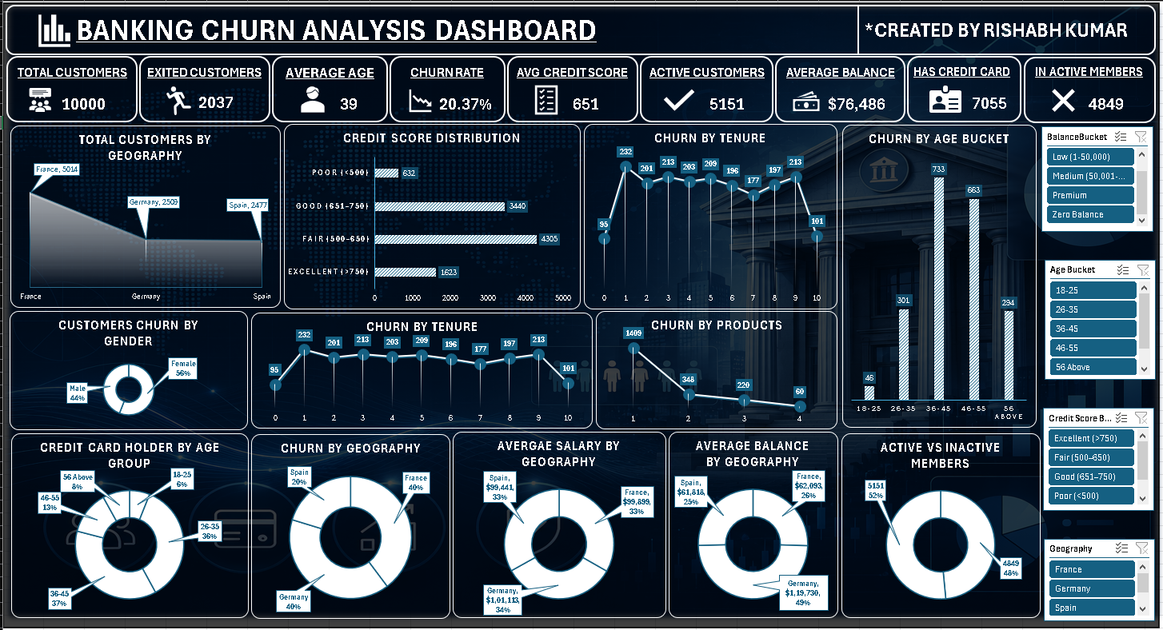
EXCEL DASHBOARD

Slide 6

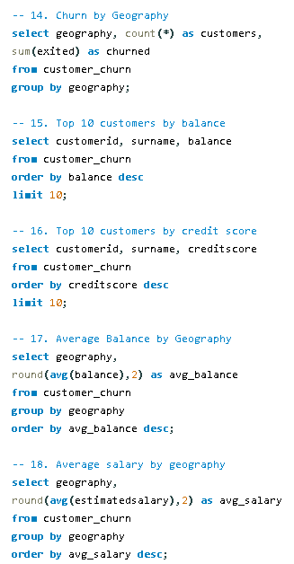
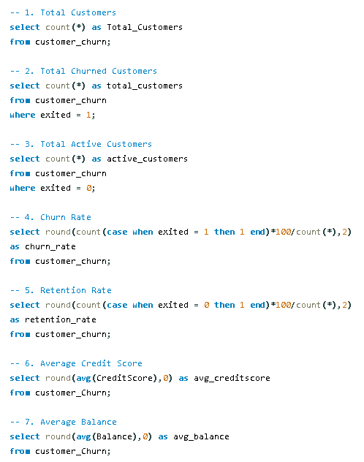
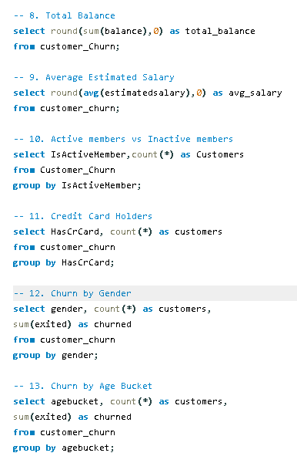
SQL QUERIES

Slide 7

KEY INSIGHTS
Approximately 20% of consumers have churned, underscoring the need for more effective retention methods.
Inactive clients are far more likely to depart than active customers.
Customers aged 40-60 have the greatest turnover rates.
Churn varies by geographic area, reflecting location-specific customer behavior.
Customers with only one banking product are more likely to leave than those with many products.
Higher account balance consumers have significant turnover, necessitating aggressive interaction.
Lower credit ratings and shorter tenure are related with increased turnover risk.
Personalized offers, cross-selling, and predictive analytics can boost client retention and long-term profitability.

Slide 8

CONCLUSION
The Banking Customer Churn Analysis study was effective in identifying the primary variables impacting customer attrition by evaluating customer demographics, financial behavior, and account activity.
The research, conducted using Excel and SQL indicated that customer interaction, product uptake, tenure, and geographic location all had a substantial influence on turnover.
The interactive dashboard enables stakeholders to track key performance indicators, identify high-risk consumer categories, and make data-driven choices.
The findings and recommendations support proactive retention tactics, which may help banks increase customer happiness, minimize churn, develop long-term client relationships, and boost overall business profitability.

Slide 9

THANK YOU

